Slide 1
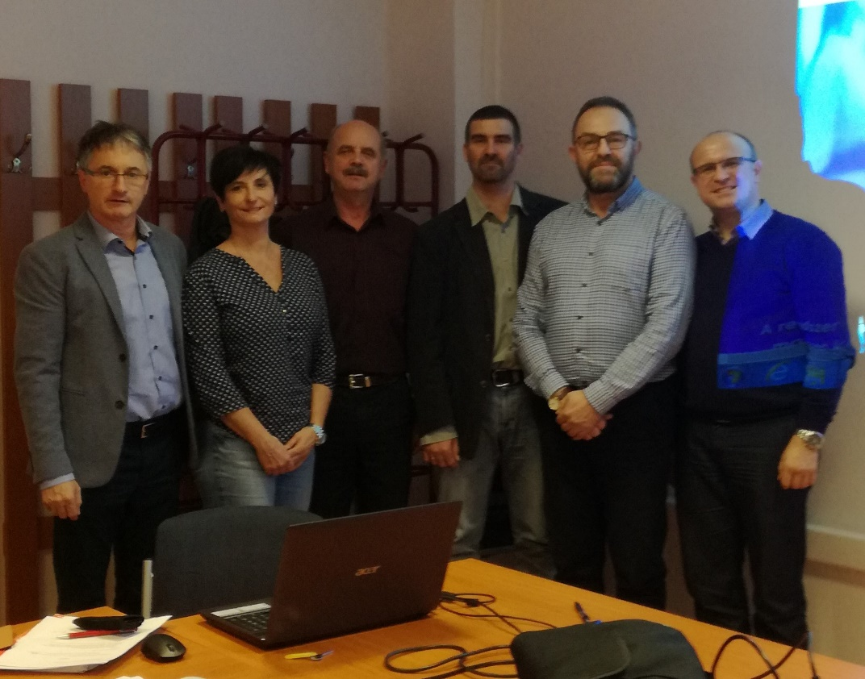
EFOP PROJECT MEETING
Szeged, July 5, 2019
NITRA - SlovakIA Report

Slide 2
MEASUREMENTS IN NITRA, SLOVAKIA
Total number of children measured (2 times): 109
Number of schools involved: 4
Number of administrators: 2 pedagogues
3 university students
Number of working days spent: 8 + 7 days
Measurement months: 12/2018 + 5/2019 ...10/2019

Slide 3
MEASUREMENTS IN NITRA, SLOVAKIA
Locomotion/measurement | No.1 | No.2 | Increment | % | Value
Run | 5.904 | 6.398 | 0.494 | 8.37 | 6.
Gallop | 5.416 | 6.304 | 0.888 | 16.38 | 3.
Hop | 7.584 | 8,609 | 1.025 | 13.52 | 5.
Leap | 4.512 | 5.287 | 0.775 | 17.18 | 1.
Horizontal jump | 5.664 | 6.626 | 0.962 | 16.98 | 2.
Slide | 5.736 | 6.617 | 0.881 | 15.36 | 4.
Average rate of improvement |  |  |  | 14.63

Slide 4
MEASUREMENTS IN NITRA, SLOVAKIA
Skills/measurement | No.1 | No.2 | Increment | % | Value
Striking | 3.94 | 5.3 | 1.36 | 34.52 | 6.
Dribbling | 2.54 | 4.58 | 2.1 | 80.71 | 1.
Catching | 3.11 | 4.52 | 1.41 | 45.34 | 3.
Kicking | 3.70 | 5.15 | 1.45 | 39.19 | 5.
Throwing | 2.48 | 4.17 | 1.68 | 67.74 | 2.
Rolling | 2.94 | 4.25 | 1.32 | 44.90 | 4.
Average rate of improvement |  |  |  | 52.07

Slide 5
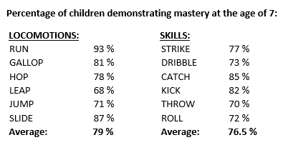
MEASUREMENTS IN NITRA, SLOVAKIA

Slide 6
MEASUREMENTS IN NITRA, SLOVAKIA
A: LOCOMOTIONS
1st measurement: 72.48 % of pupils scored over 75 % of max. no. of pts.
2nd measurement: 94.5 % of pupils scored over 75 % of max. no. of pts.
B: SKILLS
1st measurement: 2.75 % of pupils scored over 75 % of max. no. of pts.
2nd measurement: 12 % of pupils scored over 75 % of max. no. of pts.

Slide 7
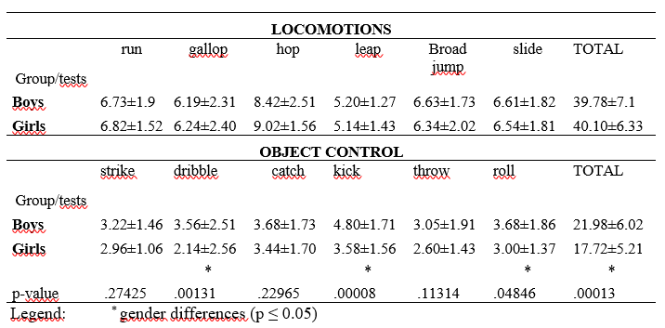
MEASUREMENTS IN NITRA, SLOVAKIA

Slide 8
MEASUREMENTS IN NITRA, SLOVAKIA
PROBLEMS AND CHALLENGES:
Parents disapproval with interviews
High illness rate of pupils
Subjectiveness of assessment
POSITIVE ASPECTS:
Good cooperation of class-teachers
Interest in further projects
Enjoyment of children

