Slide 1
Complex, comparative analysis of the interactions between regular physical activity, motor abilities, body composition and quality of life among early school age Slovak,Romanian and Hungarian pupils (Project ID: EFOP-5.2.2-17-2017-00035)
International project workshop
05. July 2019
Szeged,
Hungary

Slide 2
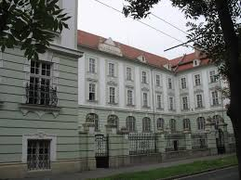
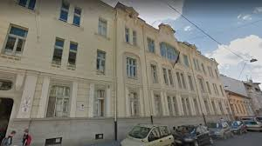
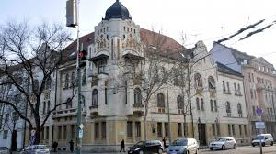
Report on project’s second measurement period in Szeged
Gyula Juhász Primary School
Madách Primary School
Ságvári Primary School

Slide 3
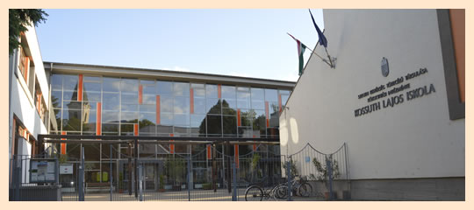
189 pupils in the first measurement period
we looked up one more school,
measured 52 new pupils (with parental permission and additional questions)
cumulatively we measured
237 children in the second phase
Data digitalisation is finished last week, the statistical analysis is in progress
Kossuth Lajos School

Slide 4
Experiences
The second period was easier and faster, because
the measurements were familiar to the schoolmasters/directors, headmasters, PE and other teachers and mainly the pupils and their parents;
our university undergraduates and PhD students involved in the measurement were more practised and they had more routine; (In the end of the summer we have to train new undergraduates instead of those who passed their final exam and finished the university)
more thoughtful schedule and use of place in the sports hall.

Slide 5
Questions of the workshop
Parental problems – ethical statement
3rd period: printed questionnaires, additional questions? tight deadlines
Conferences: Arad (23-25 May, 2019) Komarno (5-7 September ,2019) Cluj-Napoca (10-11 October, 2019) Szeged –Project closing conference (… December, 2019)
Publications (Supported by EFOP-5.2.2-17-2017-00035)
Press releases
Translation of the project’s website

Slide 6
ISREIE 2019 Arad (23-25 May, 2019)
AH Molnár1, VP Ardelean2, ÁV Nagy1, B Vári1, K Orbán1,
Cs Fintor1, T Ocskó1, R Szász1, F Győri1, B Dobay3,
I Boros-Bálint4, GF Deak4, J Simonek5, N Halmová5,
I Alattyányi6, R Csetreki6, VL Andrei2
1 University of Szeged, Institute of PE and Sports Science, Szeged, Hungary
2 Aurel Vlaicu University, Faculty of PE and Sport, Arad, Romania
3 J. Selye University, Department of PE and Sports, Komarno, Slovakia
4 Babeş-Bolyai University, Department of Kinesiotherapy and Theoretical Disciplines, Cluj-Napoca, Romania
5 Constantine the Philosopher University, Deparment of PE and Sport, Nitra, Slovakia
6 Foundation for the Sustainable Development of our Society, Szeged, Hungary
Introduction of a longitudinal international (RO-SVK-HU) study
about body composition, motor development and quality of life
among 6-7-year-old pupils

Slide 7
„SPORT SCIENCE IN MOTION“ Komarno 5-7 September, 2019
AH Molnár1, J Simonek2, N Halmová2, I Boros-Bálint3, GF Deak3,
VP Ardelean4, VL Andrei4, ÁV Nagy1, B Vári1, K Orbán1, Cs Fintor1,
T Ocskó1, R Szász1, G Olajos1, F Győri1, I Alattyányi5, R Csetreki5, B Dobay6
1 University of Szeged, Institute of PE and Sports Science, Szeged, Hungary
2 Constantine the Philosopher University, Department of PE and Sport, Nitra, Slovakia
3 Babeş-Bolyai University, Department of Kinesiotherapy and Theoretical Disciplines, Cluj-Napoca, Romania
4 Aurel Vlaicu University, Faculty of PE and Sport, Arad, Romania
5 Foundation for the Sustainable Development of our Society, Szeged, Hungary
6 J. Selye University, Department of PE and Sports, Komarno, Slovakia
Motor development of Slovak and Hungarian 6-7-year-old pupils in the aspect of degree of obesity (First phase of a longitudinal study)

